Slide 1
Deadlock

Slide 2
Operating Systems
Objectives
  describe deadlock, and forms of prevention, avoidance, detection, and recovery

Slide 3
Contents
1. What is Deadlock?
2. Dealing with Deadlock
3. Deadlock Prevention
4. Deadlock Avoidance
5. Deadlock Detection
6. Deadlock Recovery

Slide 4
1. What is Deadlock?
An example from US Kansas law:
  “When two trains approach each other at a crossing, both shall come to a full stop and neither shall start up again until the other has gone.”

Slide 5
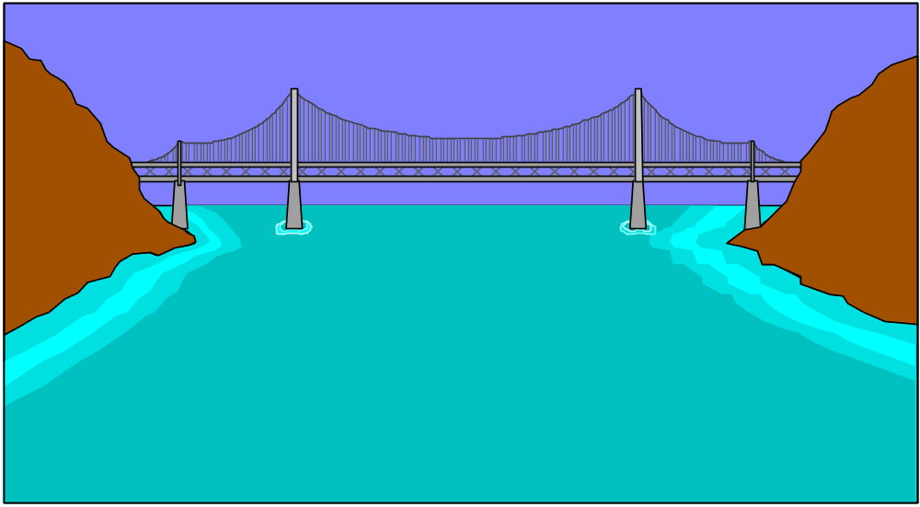


In Picture Form:
Neither truck can proceed.

Slide 6
1.1. System Deadlock
A process must request a resource before using it, and must release the resource after finishing with it.
A set of processes is in a deadlock state when every process in the set is waiting for a resource that can only be released by another process in the set.

Slide 7
1.2. Necessary Conditions for Deadlock
Mutual Exclusion
  at least one resource must be held in
  non-shareable mode
Hold and Wait
  a process is holding a resource and waiting for others
continued

Slide 8
No Preemption
  only the process can release its held resource
Circular Wait
  {P₀, P₁, …, P_{n}}
  P_{i} is waiting for the resource held by P_{i+1};
  P_{n} is waiting for the resource held by P₀

Slide 9
1.3. Resource Allocation Graph
A set of processes {P₀, P₁, …}
A set of resource types {R₁, R₂, …}, together with instances of those types.
P_{j}
R_{k}

Slide 10
Edge Notation
P_{i} → R_{j}
  process i has requested an instance of resource j
  called a request edge
R_{j} → P_{i}
  an instance of resource j has been assigned to process i
  called an assignment edge

Slide 11
Example Graph
R₁
R₃
P₁
P₂
P₃
R₄
R₂

Slide 12
Finding a Deadlock
If the graph has no cycles then there are no deadlock processes.
If there is a cycle, then there may be a deadlock.

Slide 13
Graph with a Deadlock
R₁
R₃
P₁
P₂
P₃
R₄
R₂

Slide 14
Graph without a Deadlock
R₁
P₂
P₁
P₃
R₂
P₄

Slide 15
2. Deadling with Deadlocks
Stop a deadlock ever occuring
  deadlock prevention
    disallow at least one of the necessary conditions
  deadlock avoidance
    see a deadlock coming and alter the process/resource allocation strategy
continued

Slide 16
Deadlock detection and recovery
Ignore the problem
  done by most OSes, including UNIX
  cheap solution
  infrequent, manual reboots may be acceptable

Slide 17
3. Deadlock Prevention
Eliminate one (or more) of:
  mutual exclusion
  hold and wait
  no preemption (i.e. have preemption)
  circular wait

Slide 18
3.1. Eliminate Mutual Exclusion
Shared resources do not require mutual exclusion
  e.g. read-only files
But some resources cannot be shared (at the same time)
  e.g. printers

Slide 19
3.2. Eliminate Hold & Wait
One approach requires that each process be allocated all of its resources before it begins executing
  eliminates the wait possibility
Alternatively, only allow a process to request resources when it currently has none
  eliminates the hold possibility

Slide 20
3.3. Eliminate “No Preemption”
Make a process automatically release its current resources if it cannot obtain all the ones it wants
  restart the process when it can obtain everything
Alternatively, the desired resources can be preempted from other waiting processes

Slide 21
3.4. Eliminate Circular Wait
Impose a total ordering on all the resource types, and force each process to request resources in increasing order.
Another approach: require a process to release larger numbered resources when it obtains a smaller numbered resource.

Slide 22
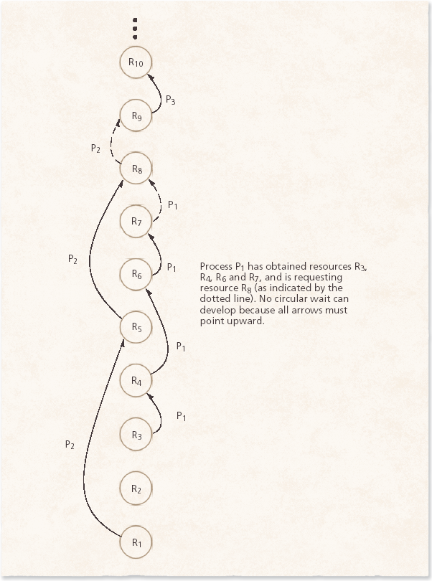
3.4 Eliminate Circular Wait
Havender’s linear ordering of resources to prevent deadlock

Slide 23
4. Deadlock Avoidance
In deadlock avoidance, the necessary conditions are untouched.
Instead, extra information about resources is used by the OS to do better forward planning of process/resource allocation
  indirectly avoids circular wait

Slide 24
4.1. Safe States
An OS is in a safe state if there is a
safe sequence of process executions
<P₁, P₂, …, P_{n}>.
In a safe sequence, each P_{i} can satisfy its resource requests by using the currently available resources and (if necessary) the resources held by P_{j} (j < i)
  only when P_{j} has finished

Slide 25
Safe State Implications
A safe state cannot lead to deadlock.
An unsafe state may lead to deadlock.
Deadlock is avoided by always keeping the system in a safe state
  this may reduce resource utilization
Deadlock
Unsafe
Safe

Slide 26
Example 1
Max no. of resources: 12 tape drives
Max needs Current Allocation
P₀ 10 5
P₁ 4 2
P₂ 9 2
Currently, there are 3 free tape drives
The OS is in a safe state, since <P₁, P₀, P₂> is a safe sequence.

Slide 27
Example 2
Same as last slide, but P₂ now has 3 tape drives allocated currently.
Max needs Current Allocation
P₀ 10 5
P₁ 4 2
P₂ 9 3
The OS is in an unsafe state.

Slide 28
4.2. Using Resource Allocation Graphs
Assume a resource type only has one instance.
Add a claim edge:
  P_{i} → R_{j}
  process P_{i} may request a resource R_{j} in the future
  drawn as a dashed line
continued

Slide 29
When the resource is actually requested, the claim edge is changed to a request edge.
When an assignment is released, the assignment edge is changed back to a claim edge.
continued

Slide 30
All resources must be claimed before system start-up.
An unsafe state is caused by a cycle in the resource allocation graph.

Slide 31
Example
R₁
R₁
P₁
P₂
P₁
P₂
R₂
R₂
R₂ allocation to P₂
creates an unsafe state

Slide 32
4.3. Banker’s Algorithm
Assume that:
  a resource can have multiple instances
  the OS has N processes, M resource types
Initially, each process must declare the maximum no. of resources it will need.
Calculate a safe sequence if possible.

Slide 33
Banker Data Structures
Available[M]
  no. of available resource instances for each resource type
  e.g. Available[j] == k means K R_{j}’s
Max[N][M]
  max demand of each process
  e.g. max[i][j] == k means P_{i} wants k R_{j}’s
continued

Slide 34
Work[M]
  no. of resource instances available for work (by all processes)
  e.g. Work[j] == k means K R_{j}’s are available
Finish[N]
  record of finished processes
  e.g. P_{i} is finished if Finish[i] == true
continued

Slide 35
Allocation[N][M]
  no. of resource instances allocated to each process
  e.g. Allocation[i][j] == k
  means P_{i} currently has k R_{j}’s
Need[N][M]
  no. of resource instances still needed by each process
  e.g. Need[i][j] == k
  means P_{i} still needs k R_{j}’s
  Need[i][j] == Max[i][j] - Allocation[i][j]
continued

Slide 36
Request[N][M]
  no. of resource instances currently requested by each process
  e.g. Request[i][j] == k
  means P_{i} has requested k R_{j}’s

Slide 37
Vectors
shorthand for
referring to the
2D data structures
Allocation[i]
  resources currently allocated to P_{i}
Need[i]
  resources still needed by P_{i}
Request[i]
  resources currently requested by P_{i}

Slide 38
The Safety Algorithm
Vector Copy: Work := Available; Finish := false
Find i such that P_{i} hasn’t finished but could:
Finish[i] == false
Need[i] <= Work
If no suitable i, go to step 4.
Assume P_{i} completes:
Work := Work + Allocation[i]
Finish[i] := true
go to step 2
If for all i Finish[i] == true then Safe-State

Slide 39
Safety Example
Resource Type Instances
  A 10
  B 5
  C 7
continued

Slide 40
Allocation Max Available Need
A B C A B C A B C A B C
P₀ 0 1 0 7 5 3 3 3 2 7 4 3
P₁ 2 0 0 3 2 2 1 2 2
P₂ 3 0 2 9 0 2 6 0 0
P₃ 2 1 1 2 2 2 0 1 1
P₄ 0 0 2 4 3 3 4 3 1
The OS is in a safe state since
<P₁, P₃, P₄, P₂, P₀> is a safe sequence.

Slide 41
Request Resource Algorithm
If (Need[i] < Request[i]) then max-error
While (Available < Request[i]) do wait
Construct a new state by:
  Available = Available - Request[i]
  Allocation[i] = Allocation[i] + Request [i]
  Need[i] = Need[i] - Request [i]
If (new state is not safe) then
restore and wait

Slide 42
Request Example 1
At some time, P₁ requests an additional 1 A instance and 2 C instances
  i.e. Request[1] == (1, 0, 2)
Does this lead to a safe state?
  Available >= Request[1] so continue
  generate new state and test for safety

Slide 43
Allocation Max Available Need
A B C A B C A B C A B C
P₀ 0 1 0 7 5 3 2 3 0 7 4 3
P₁ 3 0 2 3 2 2 0 2 0
P₂ 3 0 2 9 0 2 6 0 0
P₃ 2 1 1 2 2 2 0 1 1
P₄ 0 0 2 4 3 3 4 3 3
The OS is in a safe state since
<P₁, P₃, P₄, P₀, P₂> is a safe sequence.

Slide 44
Further Request Examples
From this state, P₄ requests a further (3,3,0)
  cannot be granted, since insufficient resources
Alternatively, P₀ requests a further (0,2,0)
  should not be granted since the resulting state is unsafe

Slide 45
Weaknesses in the Banker’s Algorithm
Weaknesses in the Banker’s Algorithm
  Requires there be a fixed number of resource to allocate
  Requires the population of processes to be fixed
  Requires the banker to grant all requests within “finite time”
  Requires that clients repay all loans within “finite time”
  Requires processes to state maximum needs in advance

Slide 46
5. Deadlock Detection
If there are no prevention or avoidance mechanisms in place, then deadlock may occur.
Deadlock detection should return enough information so the OS can recover.
How often should the detection algorithm be executed?

Slide 47
5.1. Wait-for Graph
Assume that each resource has only one instance.
Create a wait-for graph by removing the resource types nodes from a resource allocation graph.
Deadlock exists if and only if the wait-for graph contains a cycle.

Slide 48
Example
Fig. 7.7, p.225
P₅
R₁
R₃
R₄
P₅
P₁
P₂
P₃
P₁
P₂
P₃
R₂
P₄
R₅
P₄

Slide 49
5.2. Banker’s Algorithm Variation
If a resource type can have multiple instances, then an algorithm very similar to the banker’s algorithm can be used.
The algorithm investigates every possible allocation sequence for the processes that remain to be completed.

Slide 50
Detection Algorithm
Vector Copy: Work := Available; Finish := false
Find i such that P_{i} hasn’t finished but could:
Finish[i] == false
Request[i] <= Work
If no suitable i, go to step 4.
Assume P_{i} completes:
Work := Work + Allocation[i]
Finish[i] := true
go to step 2
If Finish[i] == false then Pi is deadlocked

Slide 51
Example 1
Resource Type Instances
  A 7
  B 2
  C 6
continued

Slide 52
Allocation Request Available
A B C A B C A B C
P₀ 0 1 0 0 0 0 0 0 0
P₁ 2 0 0 2 0 2
P₂ 3 0 3 0 0 0
P₃ 2 1 1 1 0 0
P₄ 0 0 2 0 0 2
The OS is not in a deadlocked state since
<P₀, P₂, P₃, P₁, P₄> is a safe sequence.

Slide 53
Example 2
Change P₂ to request 1 C instance
Allocation Request Available
A B C A B C A B C
P₀ 0 1 0 0 0 0 0 0 0
P₁ 2 0 0 2 0 2
P₂ 3 0 3 0 0 1
P₃ 2 1 1 1 0 0
P₄ 0 0 2 0 0 2
The OS is deadlocked.

Slide 54
6. Deadlock Recovery
Tell the operator
System-based recovery:
  abort one or more processes in the circular wait
  preempt resources in one or more deadlocked processes

Slide 55
6.1. Process Termination
Abort all deadlocked processes, or
Abort one process at a time until the deadlocked cycle disappears
  not always easy to abort a process
  choice should be based on minimum cost

Slide 56
6.1. Process Termination
The term minimum cost depends on various factors:
What is the priority of the process
How long the process has computed and how much longer the process will compute before completing its designated task
How many and what types of resources the process has used.

Slide 57
6.1. Process Termination
The term minimum cost depends on various factors:
How many more resources the process needs in order to complete
How many processes will need to be terminated.
Whether the process is interactive or batch

Slide 58
6.2. Resource Preemption
Issues:
  how to select a resource
  (e.g. by using minimum cost)
  how to rollback the process which has just lost its resources
  avoiding process starvation

